Slide 1
Scribbler JavaScript Hackathon
Team: NaamMeinKyaRakhaHai

Slide 2
The Project
Using WebGL to run shader programs and make fractals and a music visualizer based on Perlin noise.
All the outputs generated are real time and extremely fast, thanks to the parallel processing prowess of GPUs.

Slide 3
A Very Basic Shader Program
function f(x, y){
//your shader code here
return color
}

Slide 4

Julia Set
for (i = 0; i < num_iterations; i++) {
z = func(z, c);
if (length(z) > escape_radius) {
escaped = true;
break;
}
}

Slide 5
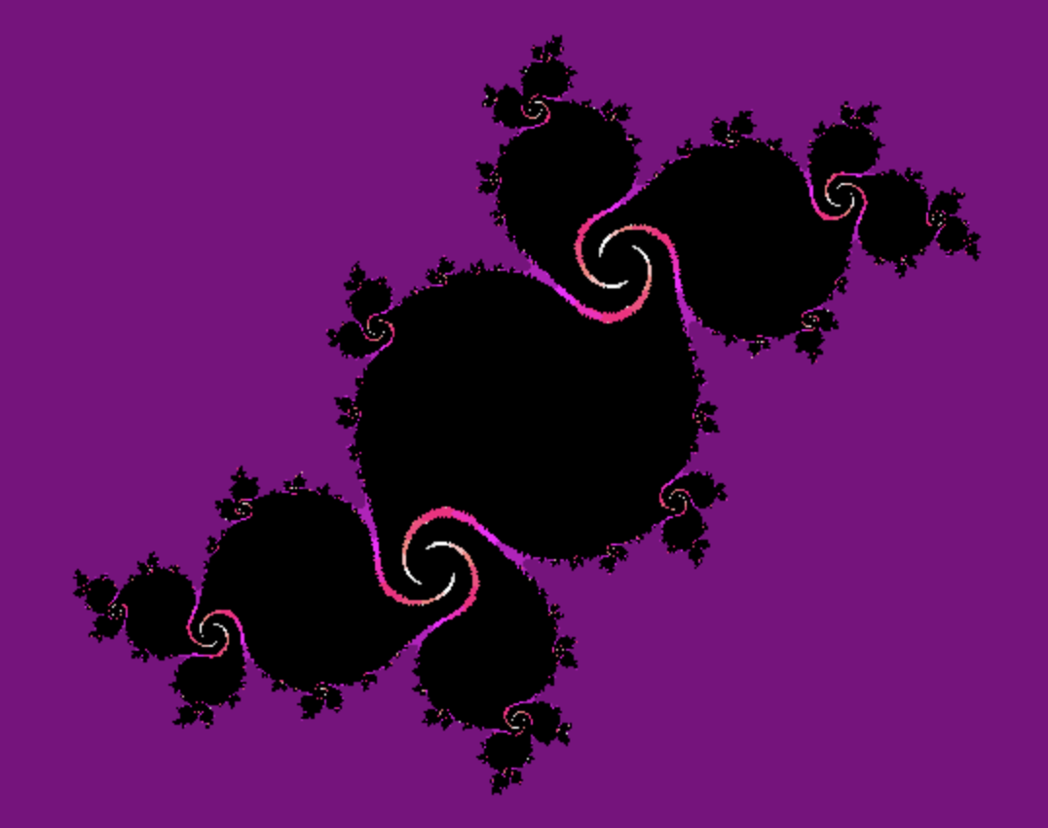
Julia Set - Implementation
Interactive: Mouse position determines c (canvas center relative to entire webpage was found using canvas.getBoundingClientRect())
Seamlessly changes shape as the mouse moves
Can be easily extended to zoom into the fractal

Slide 6
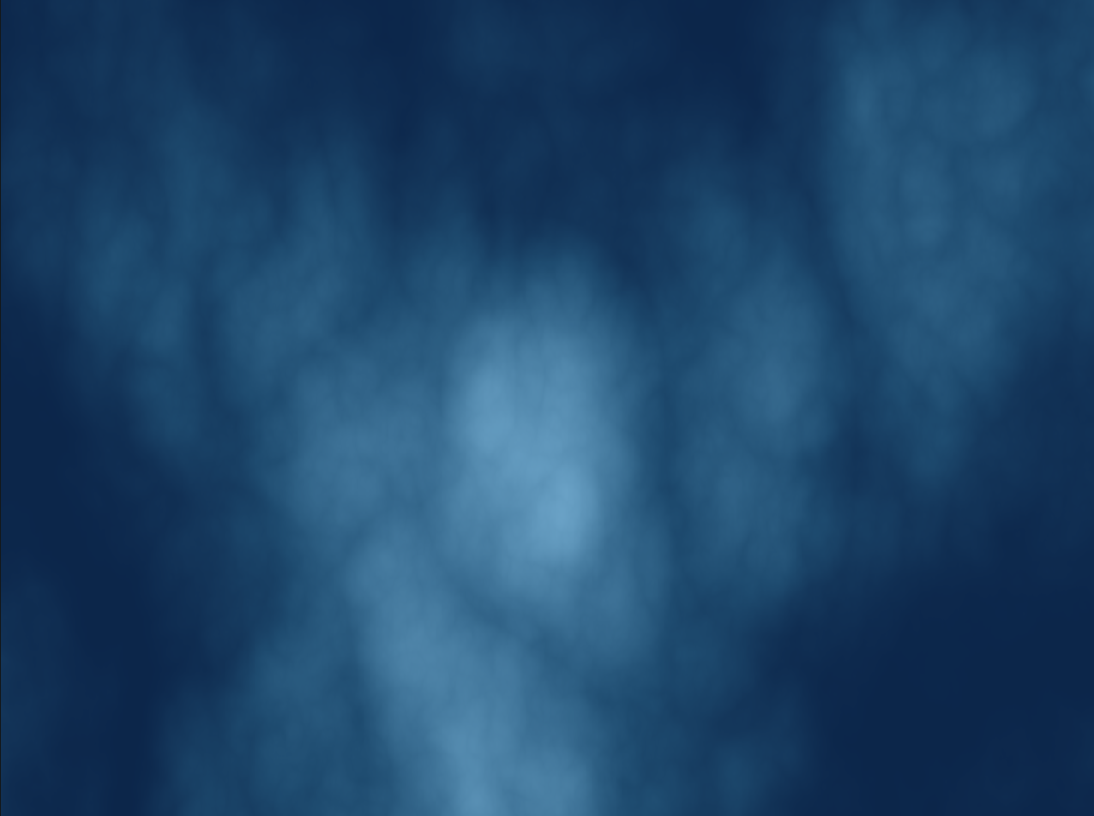
Perlin Noise
A much more organic form of random noise compared to true randomness
Parameters can be tweaked to make the output fluid, cloudy, bubbly, and a bunch of other organic textures
Just like the Julia Set, fits into the form
f(x, y) -> color

Slide 7
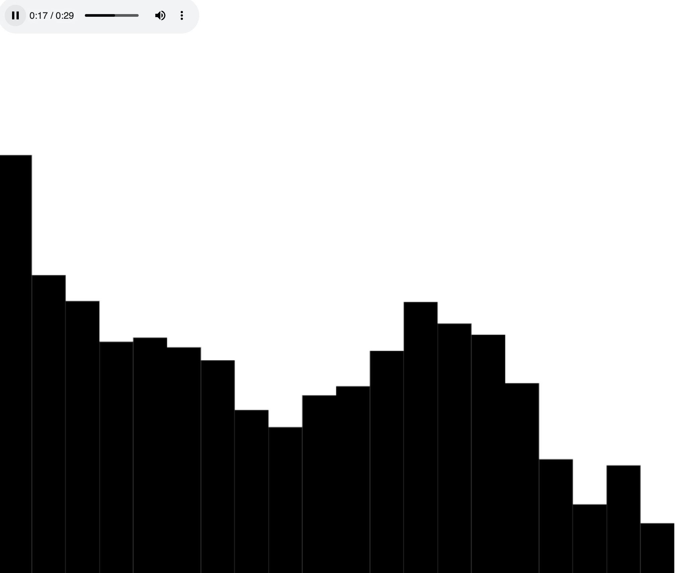
Audio Feature Extraction
Used the Deezer API to extract 30 second song previews, fetched as a XMLHttpRequest
Extracted frequency weights in the audio as a function of time using JavaScript’s Web Audio API.
Grouped frequency ranges together to construct parameters capturing broad features of the audio

Slide 8
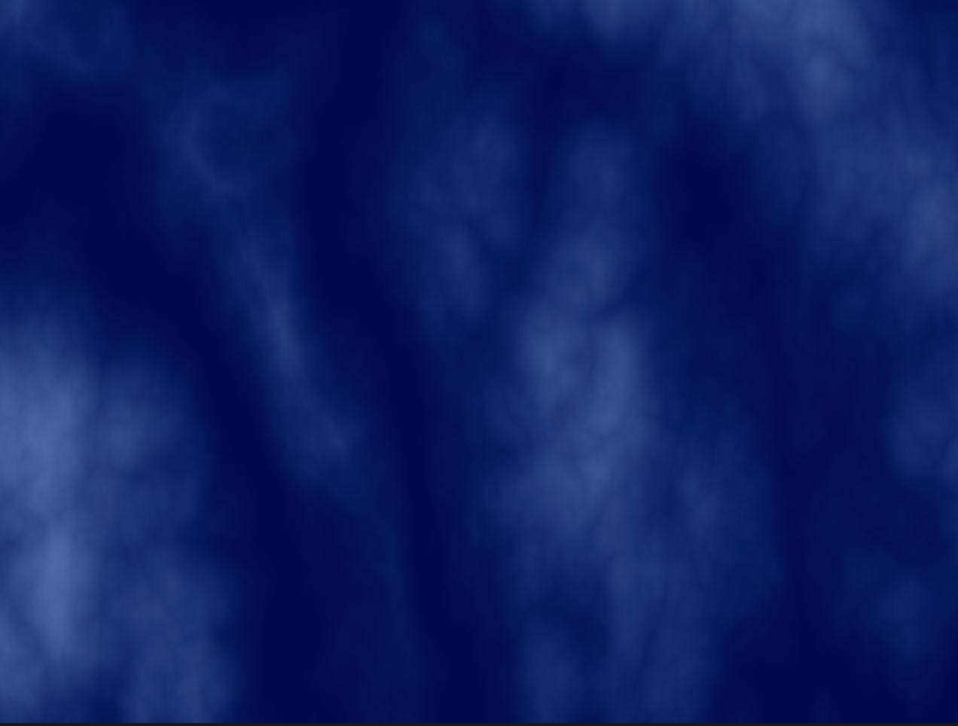

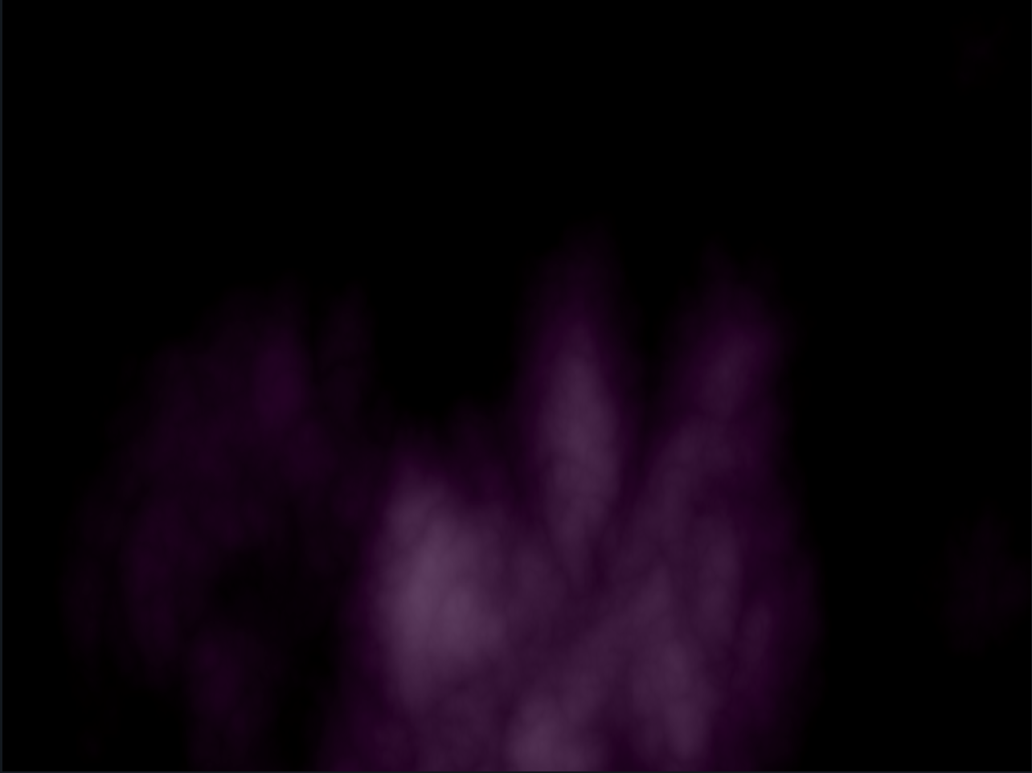
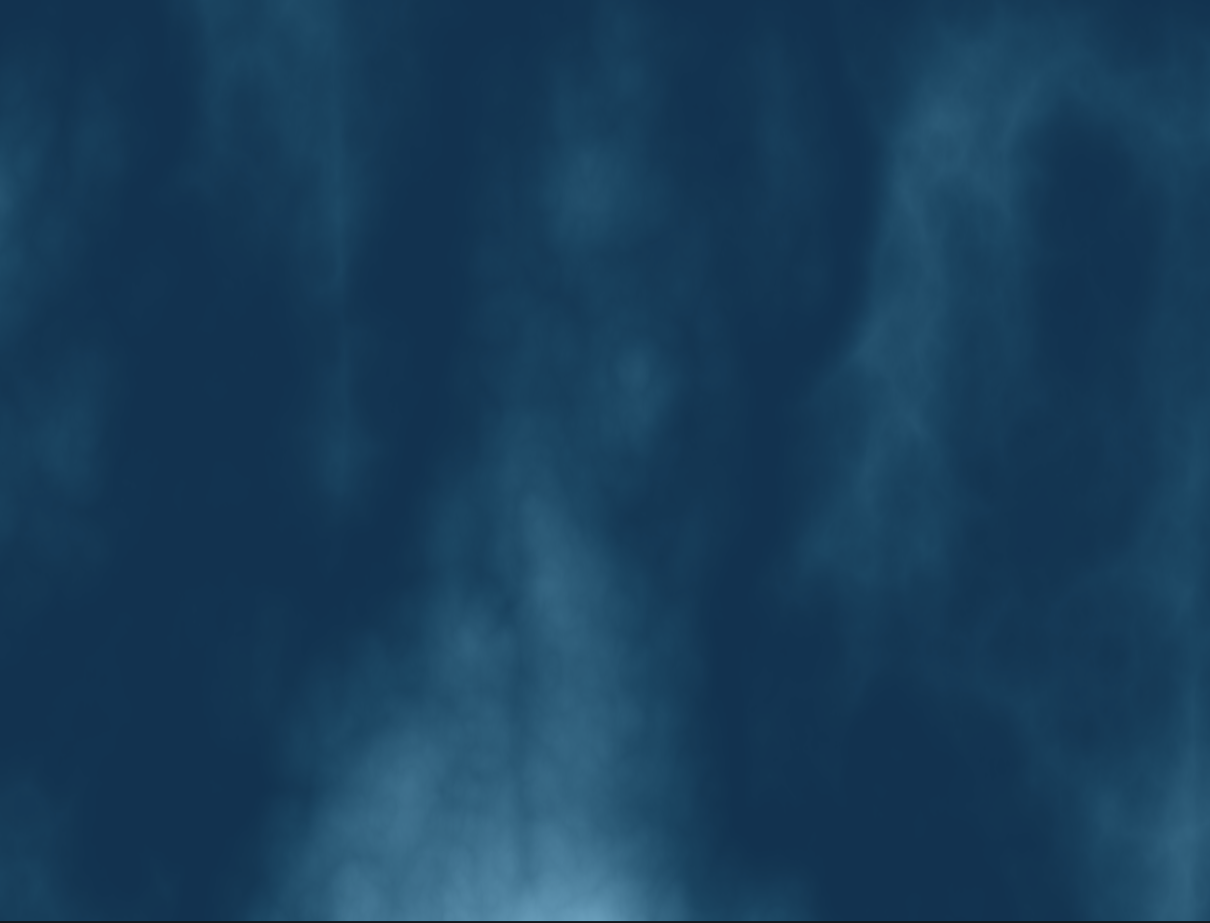
Music Visualizer
Combined all the previous work into a music visualizer
Extracted 3 frequency-based parameters, low, medium and high frequency weights as a function of time.
Low and high-freq parameters were used for changing colors
Medium frequency parameter was used to perturb the time forwards/backwards

Slide 9
Thank You :)
Team: Naam Mein Kya Rakha Hai?
Member (solo): Kaustav Prasad

